Slide 1
Project 2
Edge Detection – LoG, Canny, Matched Filter
Aditya Mulampally

Slide 2
Edge Detection
Edge detection is the process where we are able to detect fast intensity changes in the images.
It is one of the fundamental operations that is done in image processing and in computer vision, in order to learn more about the image.
In this project we learned to implement the following three filters:
Laplacian of Gaussian
Canny
Matched filter

Slide 3
Hurdles faced for edge detection
An image generally has noise in it, so it is important we model it so that it does not cause problems while detecting edges.
We are utilizing the help of smoothing filters to reduce the noise in the image.
After the noise reduction procedure we can proceed to use a gaussian based filter to find and identify the edges as it is of ideal nature.

Slide 4
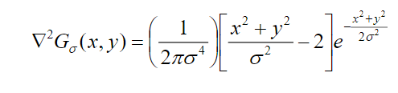
LoG for Edge Detection
In this type of edge detection we define a 2-D second order derivative which is isotropic in nature.
First the image is smoothened down with a gaussian filter and then the Laplacian of the Gaussian operation is convolved to the image.
This equation can be used to make a kernel that can be used to detect edges on the image.

Slide 5
LoG Edge Detection
After the edge detection convolution is done, a significant amount of post image processing has to be done in order to identify the proper results.
A few of these steps include:
Zero Crossing Detection
Morphing the image in order to thin the edges
Performing operations like these can yield good results.

Slide 6


Canny Detector
The canny detector also uses a gaussian based filter but it emphasizes more on the gradient magnitudes so that we can determine the edge locations and their respective directions
The above two equations are used to find the x & y magnitude of the gradients respectively. The same equations can also be used to find the angle between the pixels.
The angle is an important parameter as it is can be used for performing non-maximum supression

Slide 7
Canny – Non-Maximum Suppression
After all the gradients have been identified, they tend to leave a thick trail.
So we can use non maximum suppression to omit the values which are of less intensity along the perpendicular direction of the edge.
We can use mathematical operations such as linear interpolation to identify and highlight the most dominant edge point.
This is the general equation for the non-maximum suppression, that has to be used.
Similar post processing can also be carried out to achieve desired results.

Slide 8
Matched Filter Detection
The matched filters are implemented in a assumption such that the cross section of the image is in the form of a gaussian.
So a type of filter which is constant in one direction and gaussian in another direction can be applied to the image under this assumption.
The matched filters are also applied in a group.
The filter as it is defined in only one direction, has to be rotated in different angles so as to cover all the possible gradients orientations present in the image.
These differently oriented filters are the constituents of the group of the matched filters- where each one tries to “match” the orientation present in the image.

Slide 9

Matched Filter
This is the equation which forms the basis of the filter and is rotated in different directions.
When each of filter kernel of the group is rotated and convoluted with the original image, we obtain the various gradient orientations.
Now we can find out the maximum value of the same pixel coordinate, among all the generated images to construct an image which consists of the highest edge value.
We have to post process the final image to obtain our desired value.

Slide 10
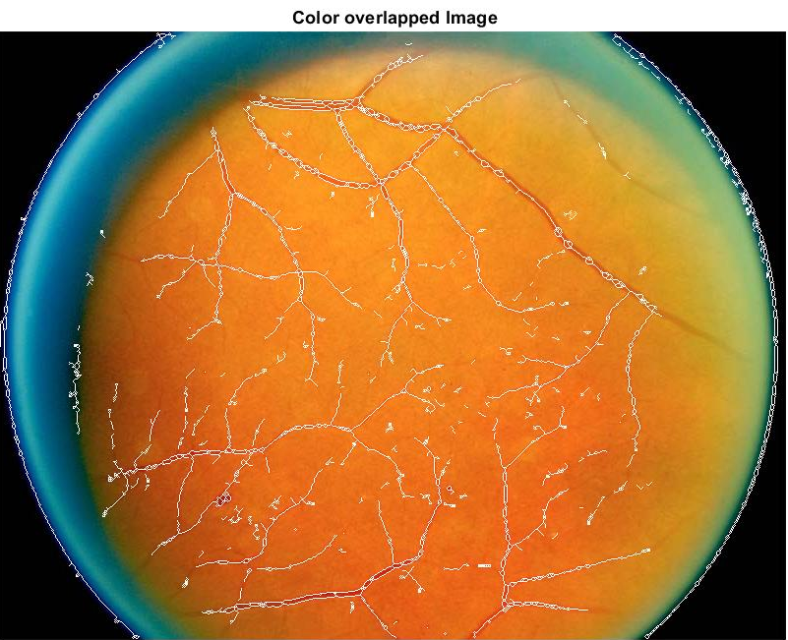
Experimental Results & Observations-LoG Filter
This is the output obtained by the LoG filter.
A sigma value of 1 was applied to blur the image.
If the sigma was increased to a value higher than 1.5 , for me the image was becoming too blurry and it was not able to detect anything.
Zero Cross detectors and morphing operations have been used to refine the edge detections.
This is the result of my most optimal value, but still I was not able to identify a few of the blood vessels which are very faint.
This method has no provision to detect edges in different orientations, it treats all edges as equal.
In the bwlabel optimization, all objects below 25 pixel areas have been omitted. This value was selected after lots of trial and error.

Slide 11
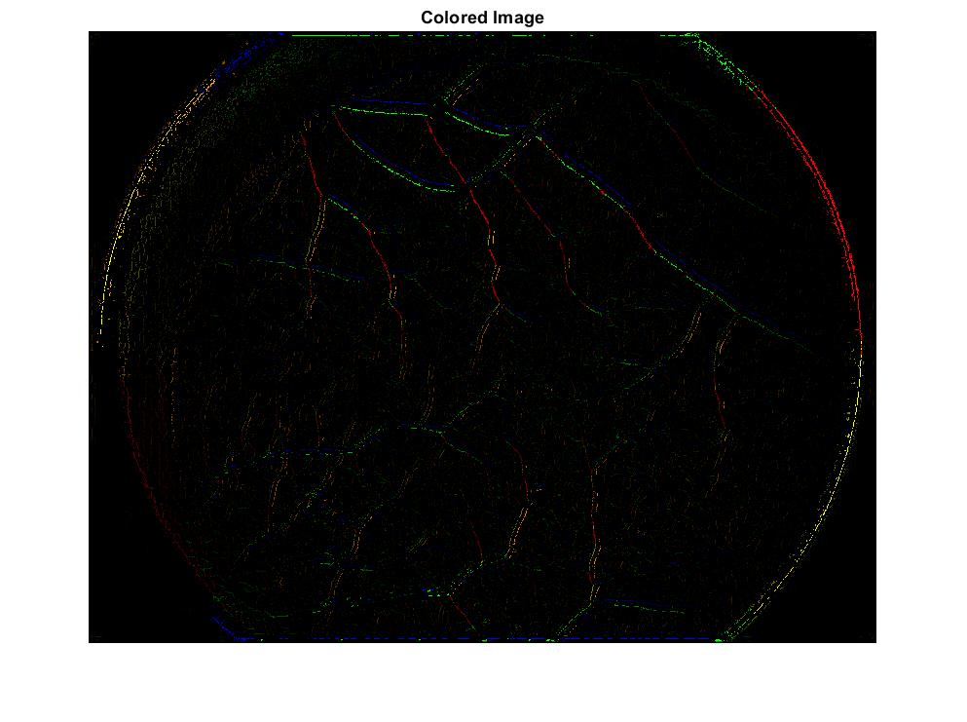
Experimental Results & Observations-Canny Filter
The x and y gradient magnitudes have been used to produce a magnitude map, which produces a very thick outlined image with edges.
The complicated part was the programming of the non maximum suppression as it took me a lot of understanding to implement it.
Non-Maximum suppression with linear interpolation has to be used in order to find the edge along the most relevant pixels.
I have tried doing the output with both with and without linear interpolation but I found that the output with linear interpolation did a better job.
The original image was again blurred by a gaussian with a sigma of 1.5
The final image was also shown by color coding all the gradients.

Slide 12

Experimental Results & Observations-Matched Filter
The matched filter did a better job at identifying the edges that were very faint in nature.
This is a filter where with a few changes in parameters, we can enhance the detection process.
Finding the mean matrix that makes the function zero mean was one of the issues I had faced in implementing this filter.
Using operations such has bwlabel operations, I chose a value below 40 pixel areas to be eliminated. This value was again found after a lot of trial and error.

Slide 13
Overall Observations
The LoG kernel filter, needed the image where it was least subjected to noise. It took some time to find the proper sigma value that works the best for the image.
As compared to the LoG filter, here in Canny it was more based on the orientations of the edges. The canny detector is faster in compilation and also it does a better job at detecting edges that are faintly visible.
I think I obtained the best results with matched filter, where I was able to detect almost all the blood vessels present in the image.
But the parameters I had set worked best for the images retina1 and retina2 only. The retina3 and retina4 images didn’t work properly. In the next slide I will show the values of the parameters that I have selected to obtain better results.

Slide 14
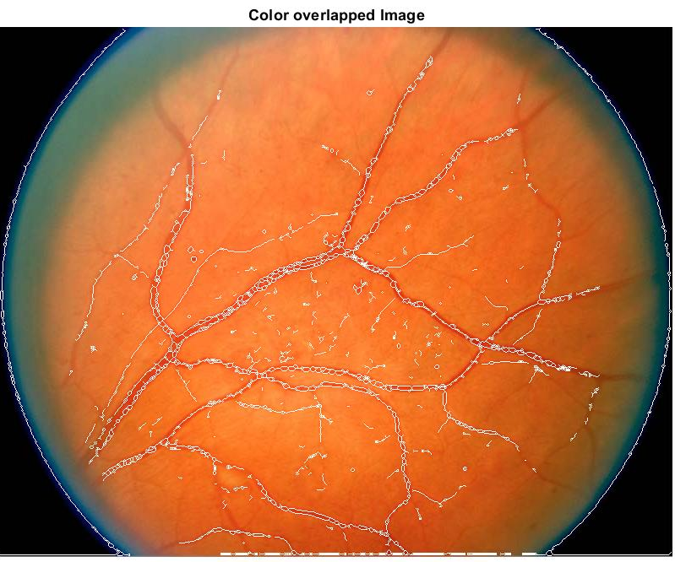
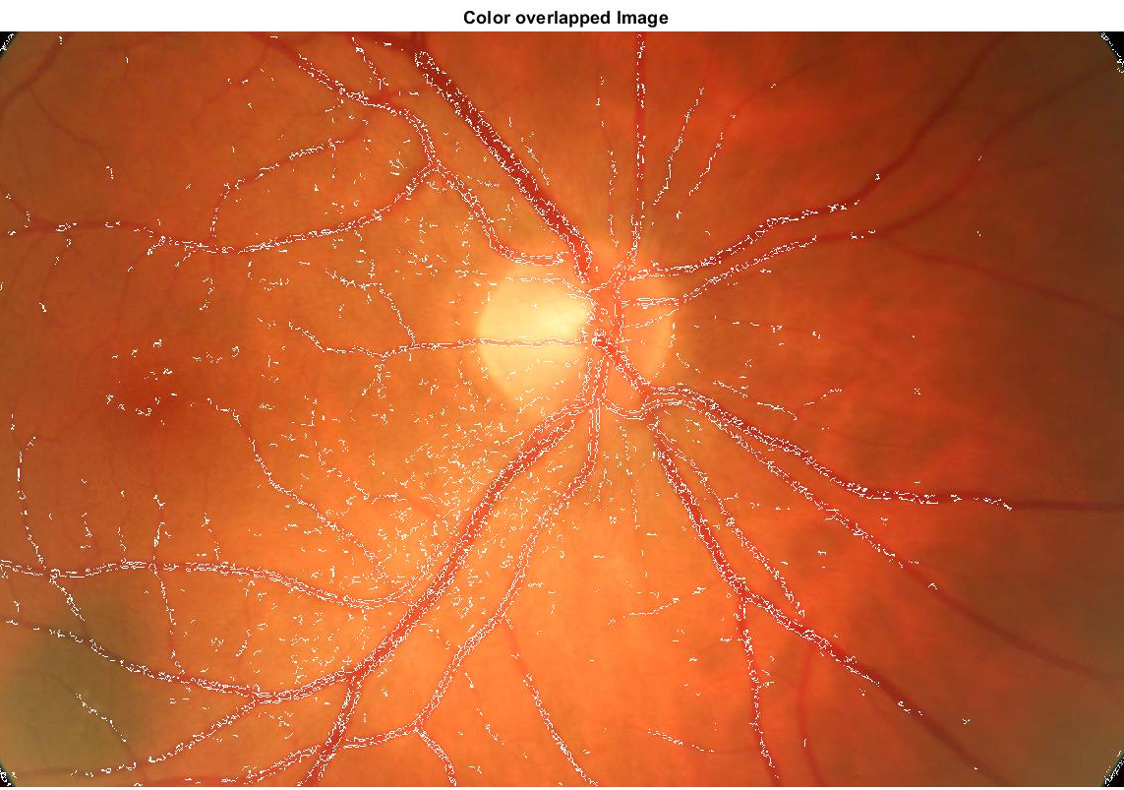
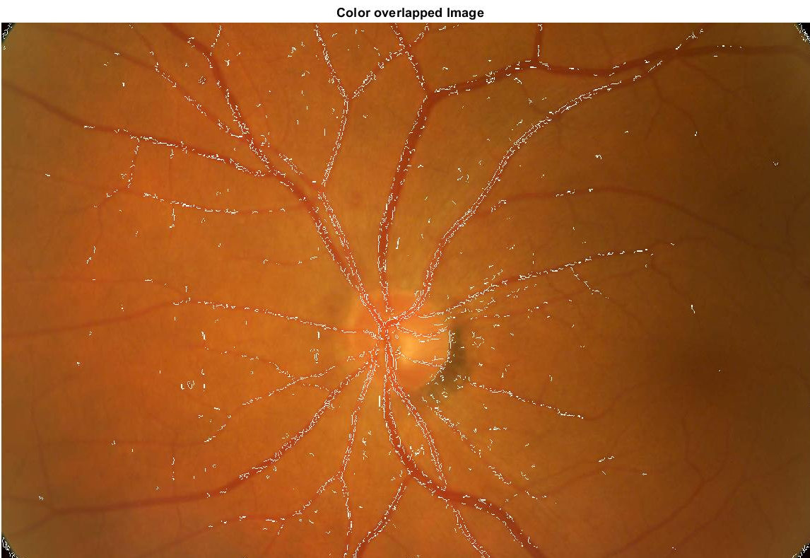
LoG Other Images Results
Used sig = 1, kernel size 3*3
Zero Crossings area < 25 have been eliminated
Used sig = 1 , but the size of the kernel is 2*2
Zero Crossings area < 35 have been eliminated
Used sig = 1 , but the size of the kernel is 2*2
Zero Crossings area < 35 have been eliminated

Slide 15
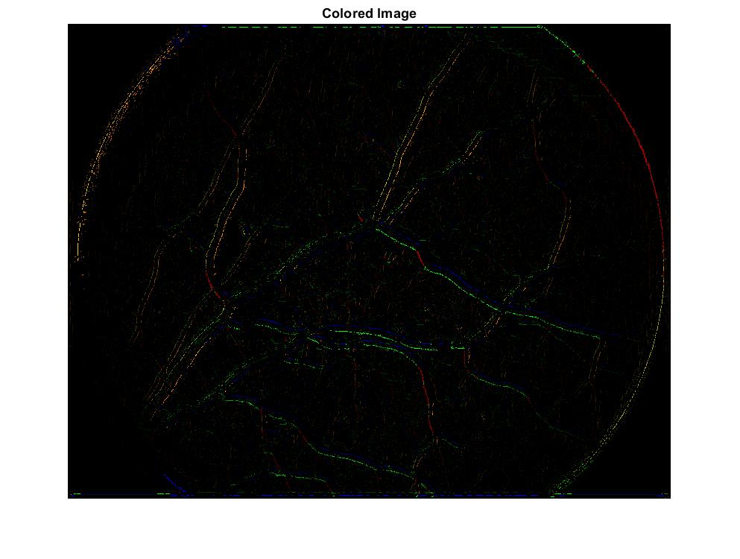
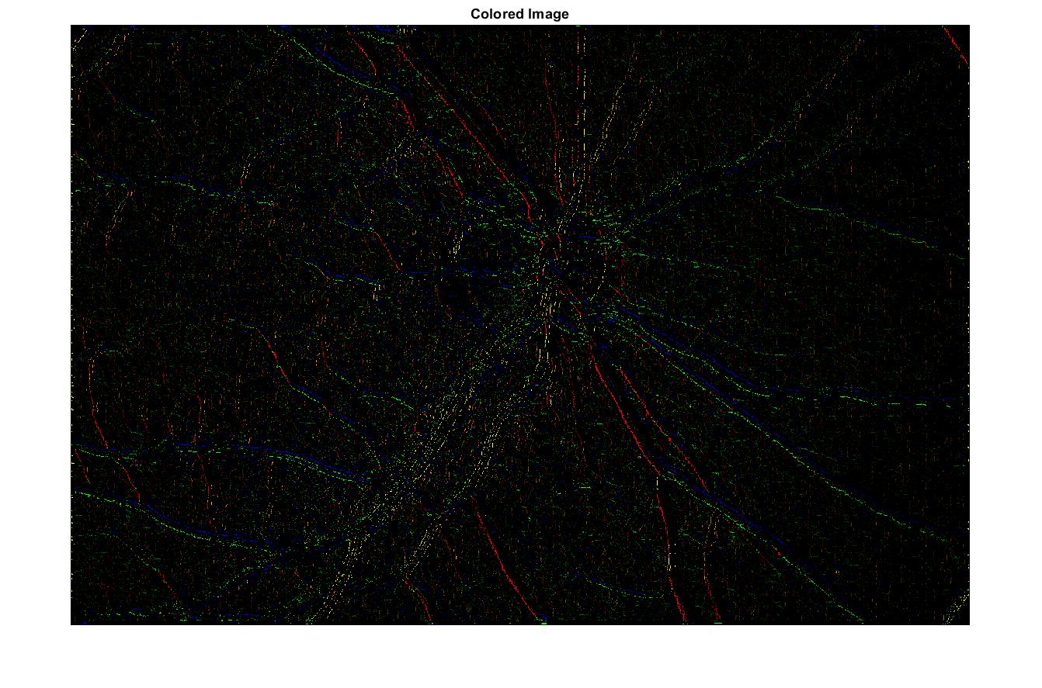
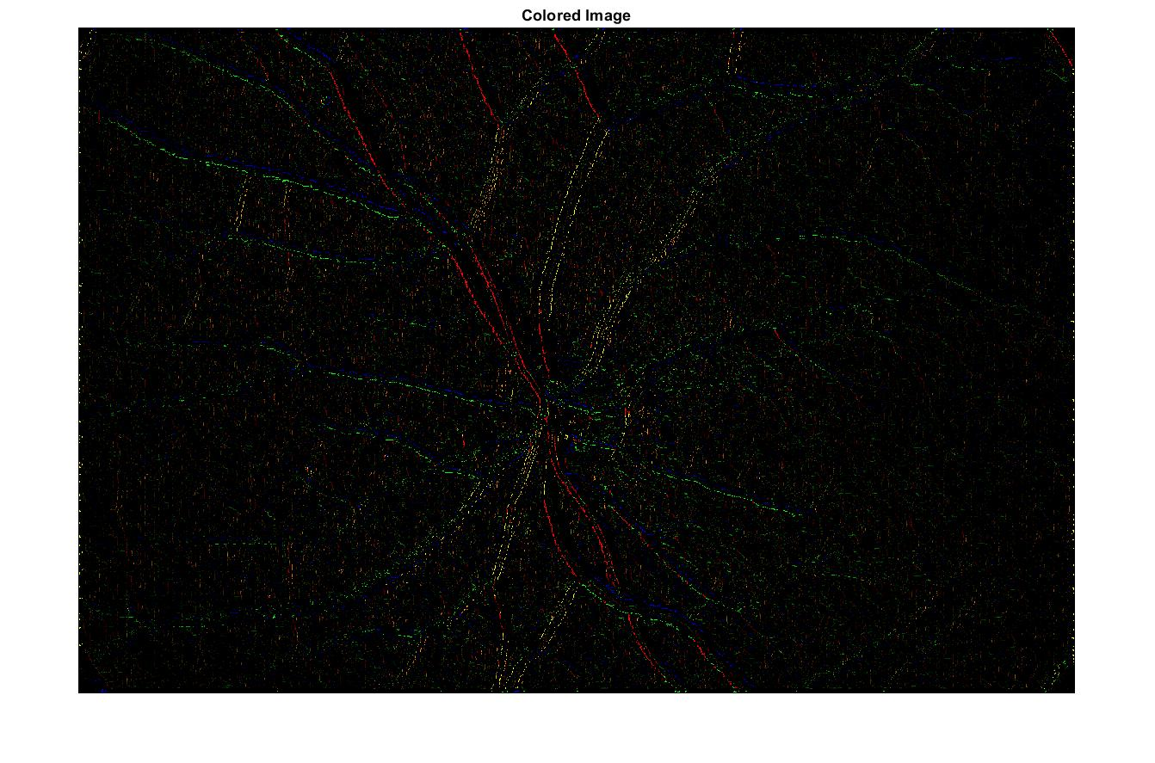
Canny Other Image Results
Sigma = 1.5
kernel size of 3*3
Sigma = 1.5
kernel size of 3*3
Sigma = 1
kernel size of 3*3
Images are not clearly visible here, please look at the output images in the folder

Slide 16
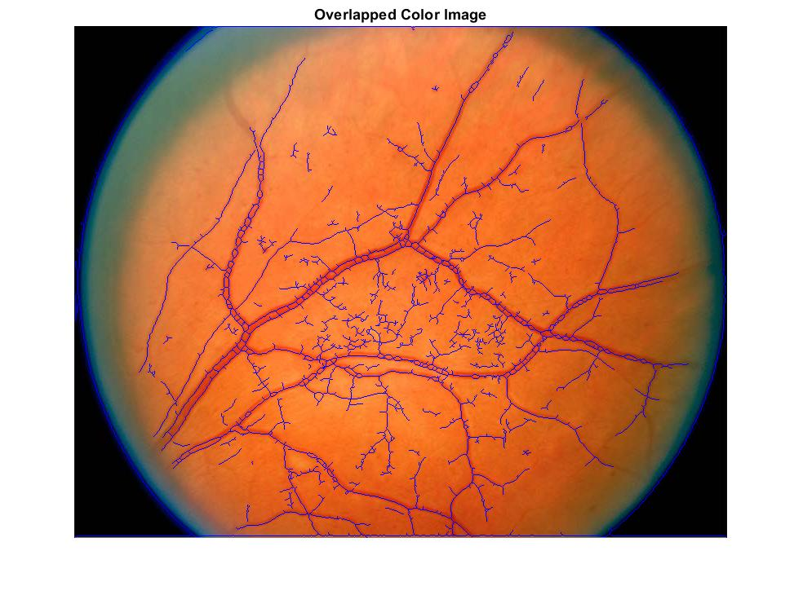
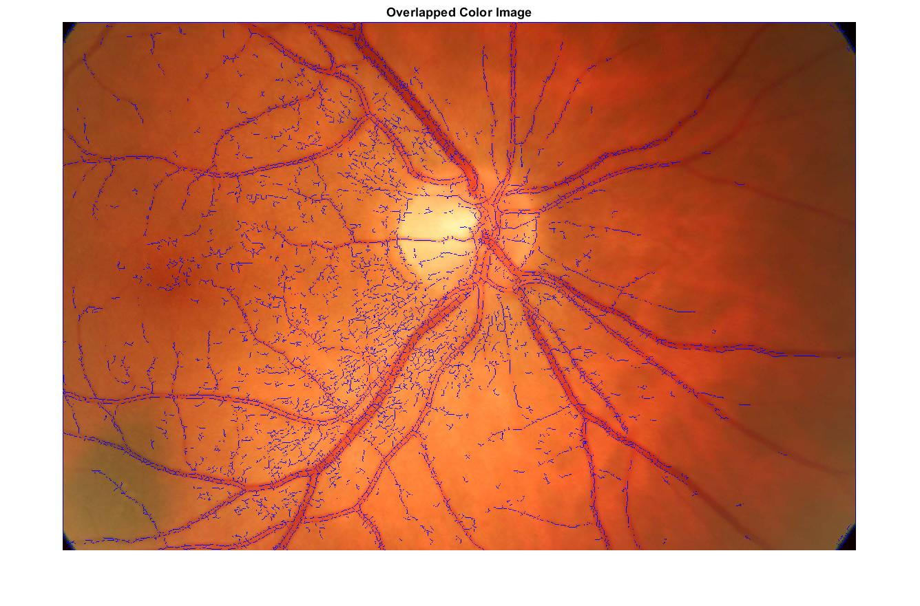
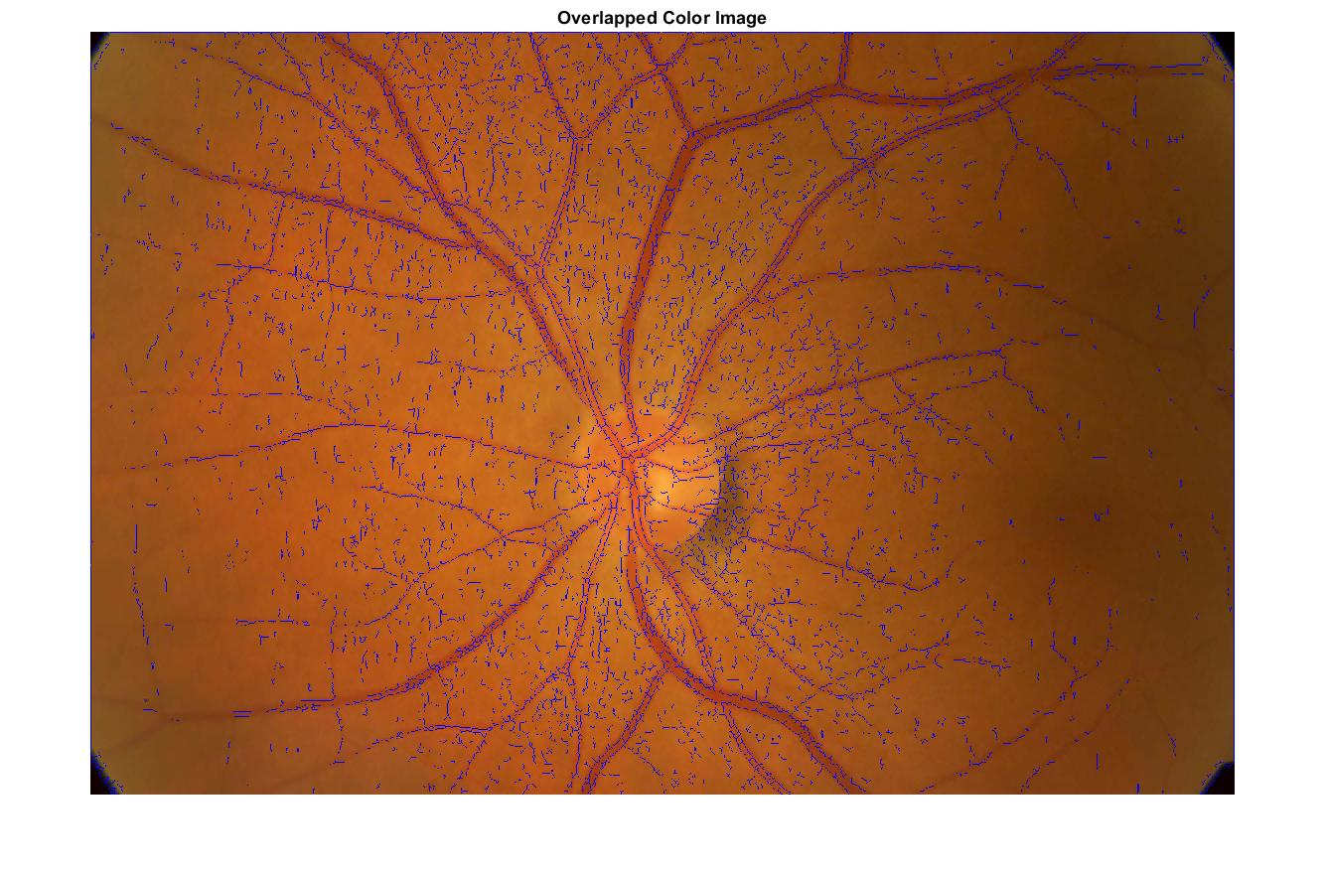
Matched Filter Other Image Results
Sigma 0.5
3*3 kernel
Zero crossings <40 have been eliminated
Sigma 0.5
3*3 kernel
Zero crossings <40 have been eliminated
Sigma 1
3*3 kernel
Zero crossings <20 have been eliminated

Slide 17
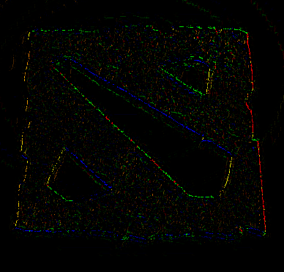
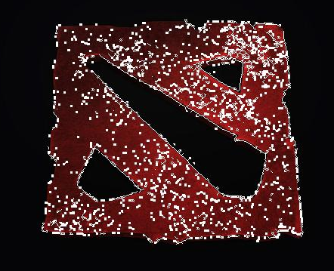
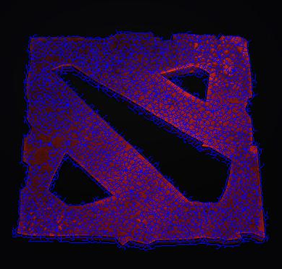
Results with other Images
I have tried edge detection with other images, the first image which is the LoG detection, struggles to find the edges even after a lot of parameter changes. The 3rd image which is the matched filter result, gives us the results of the edges but it detects all the objects inside. I’m not able to delete all these objects as matlab is detecting all these objects as the same. Here Canny detection gives us the best results.
I believe that the image I have chosen has lot of textures on it hence it is having a hard time to detect the edges.

Slide 18
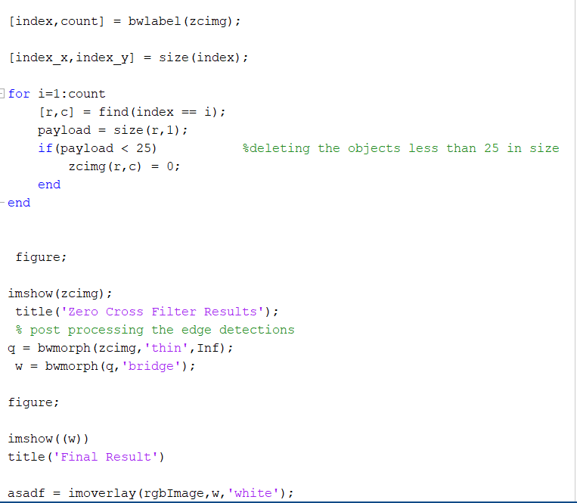
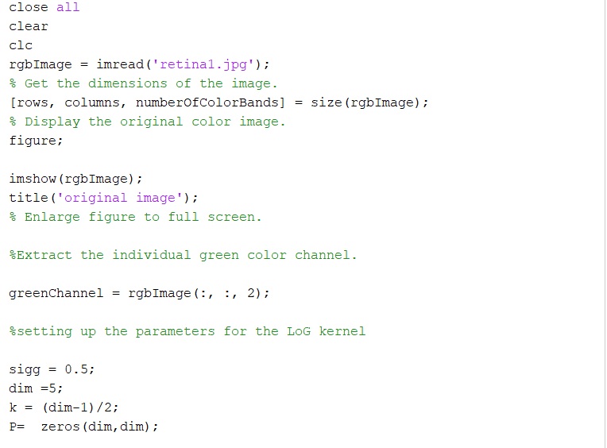
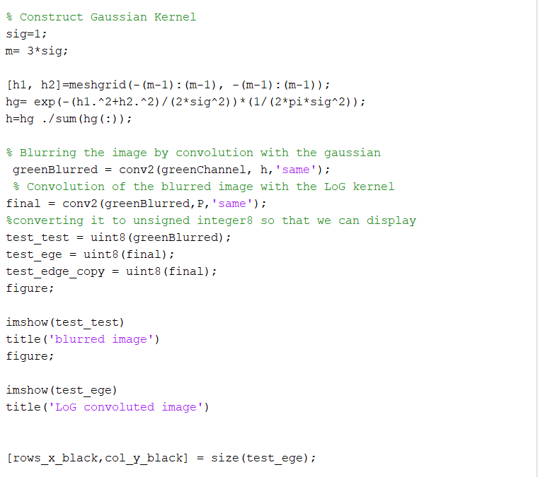
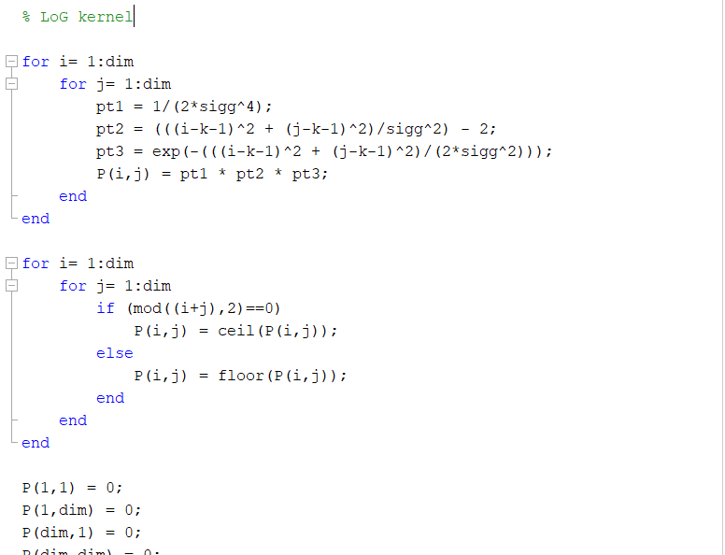
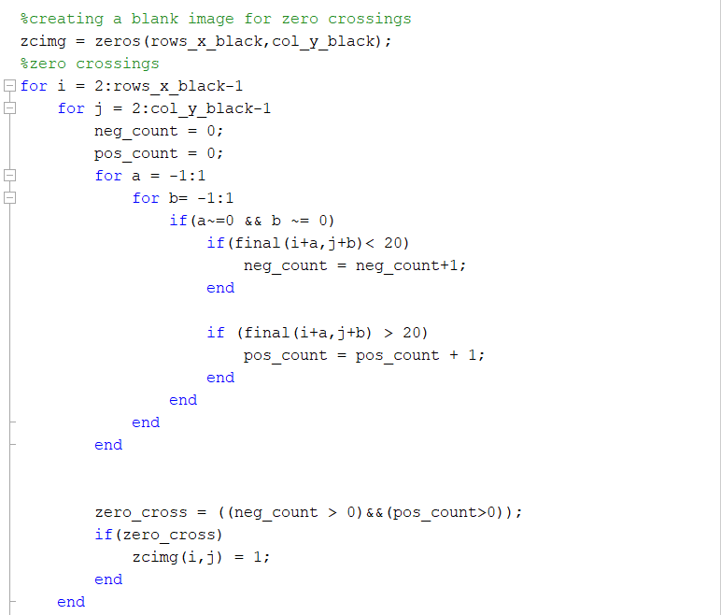
Code – LoG Detection

Slide 19
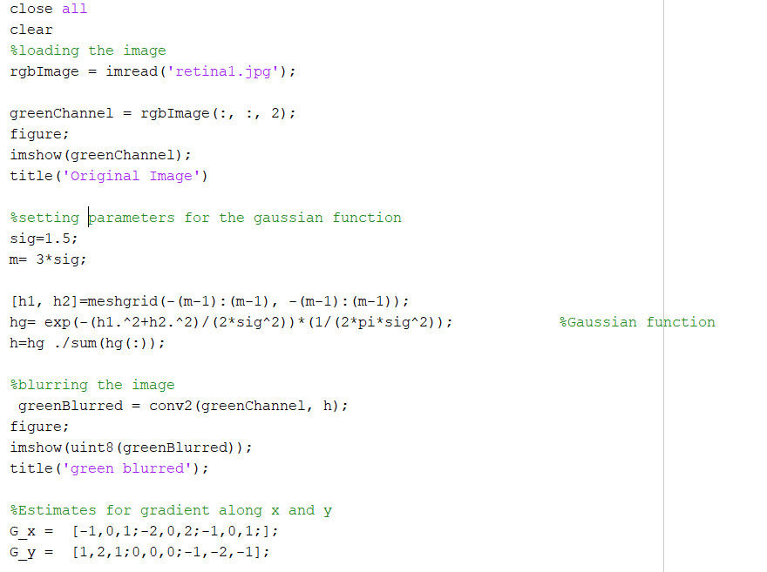
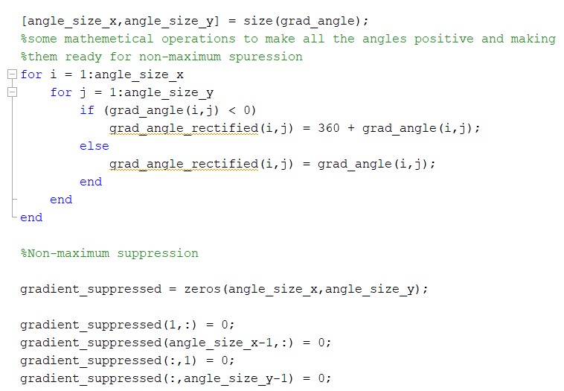
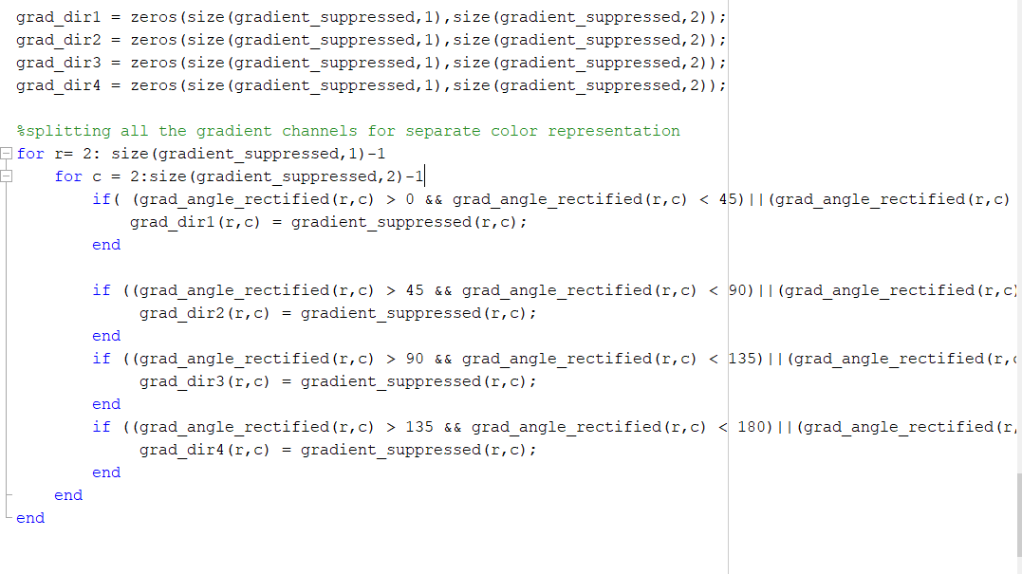
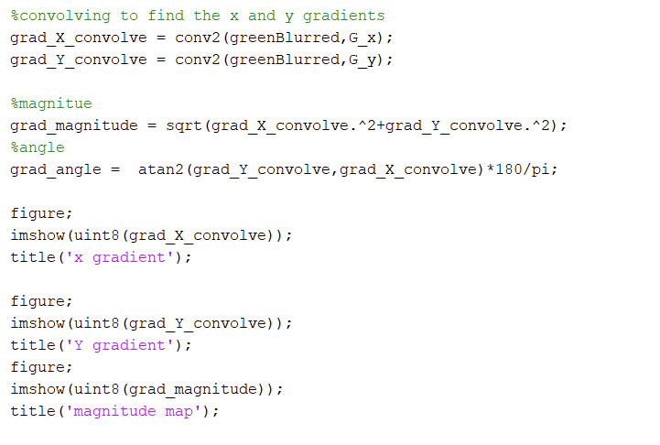
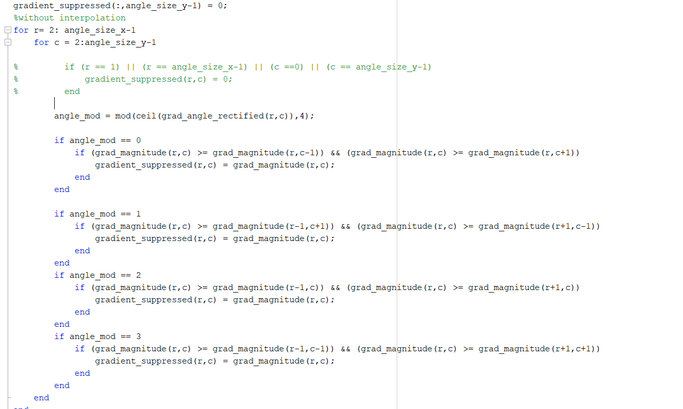
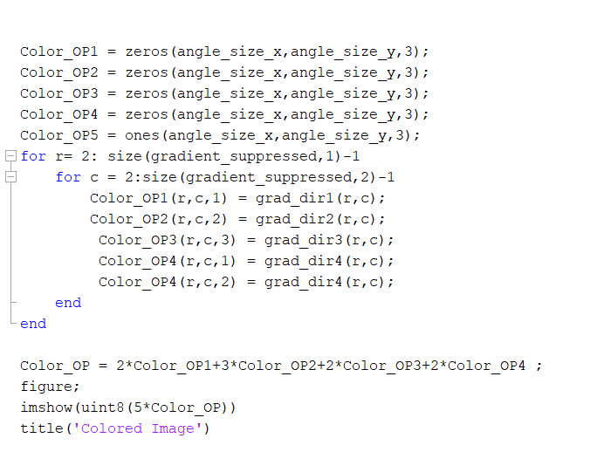
Code- Canny Detection

Slide 20
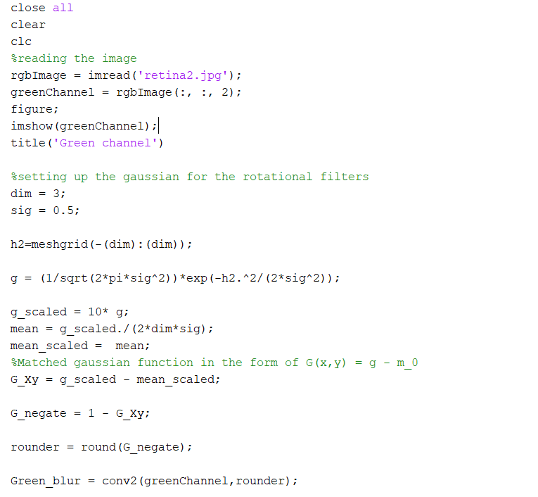
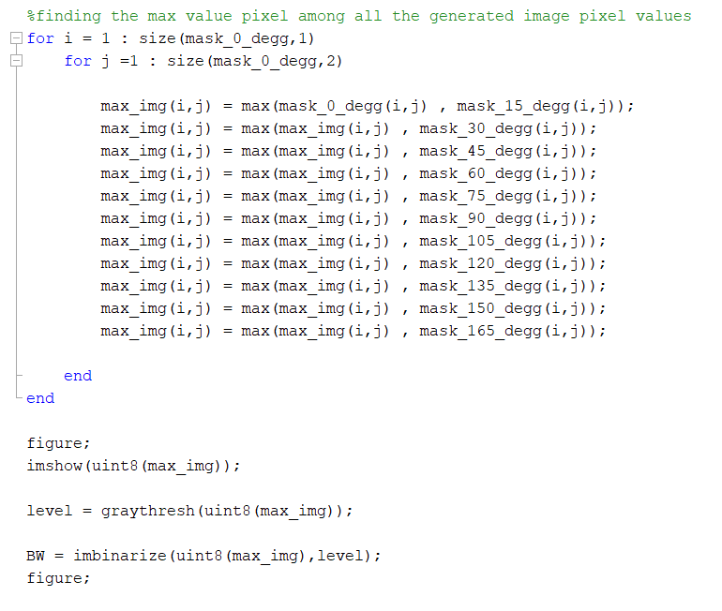
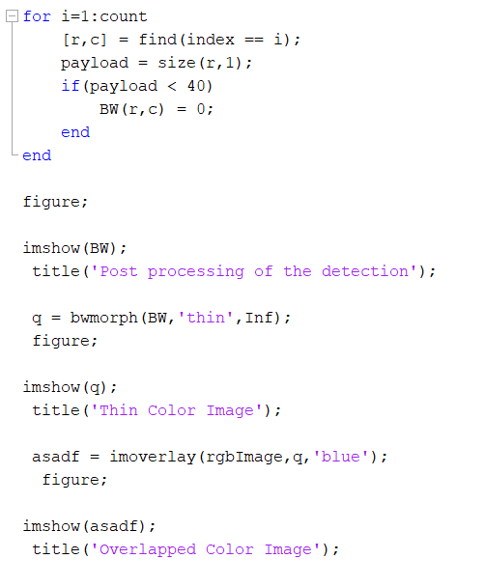
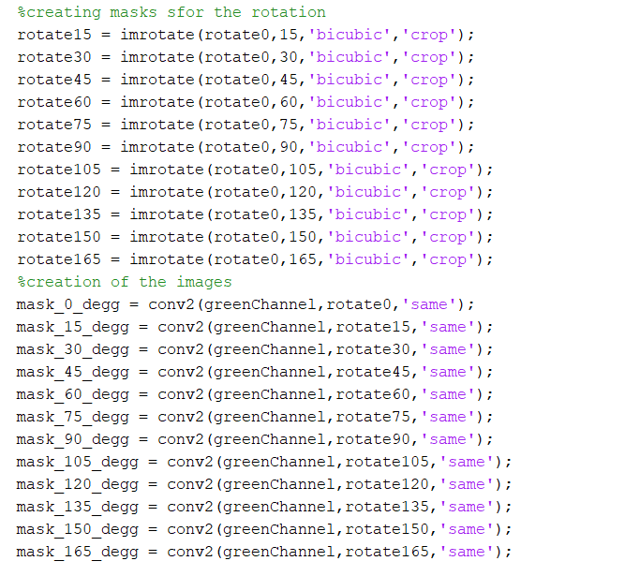
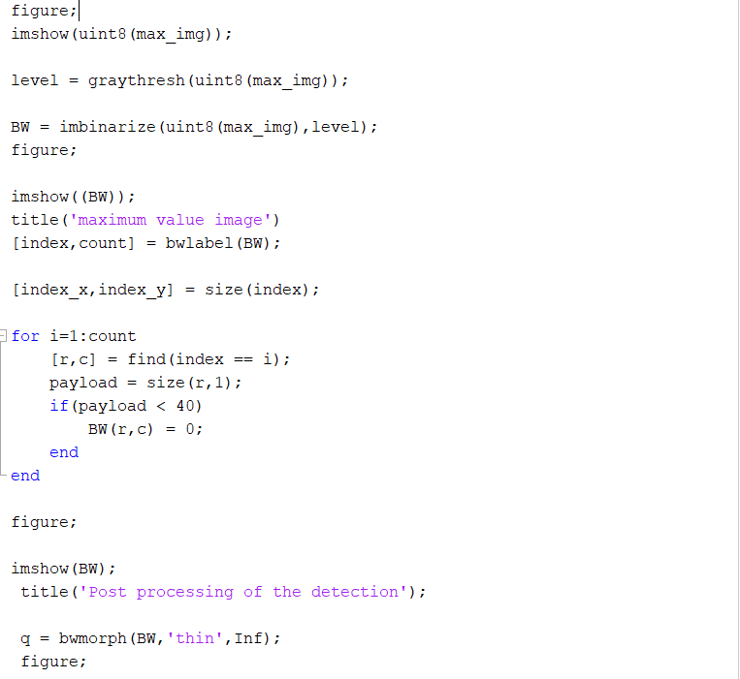
Code – Matched Filter

